Slide 1
Airbnb Data Analysis
Zhaobin Liu
12/07/2018

Slide 2
Introduction
Popularity of Airbnb
A lot of information on the Airbnb website
Data may have confusion

Slide 3
Plan
Dataset from http://tomslee.net/airbnb-data-collection-get-the-data
EDA of three cities : Boston, Seattle, Chicago
Benford Analysis of two variables : Price & Reviews

Slide 4
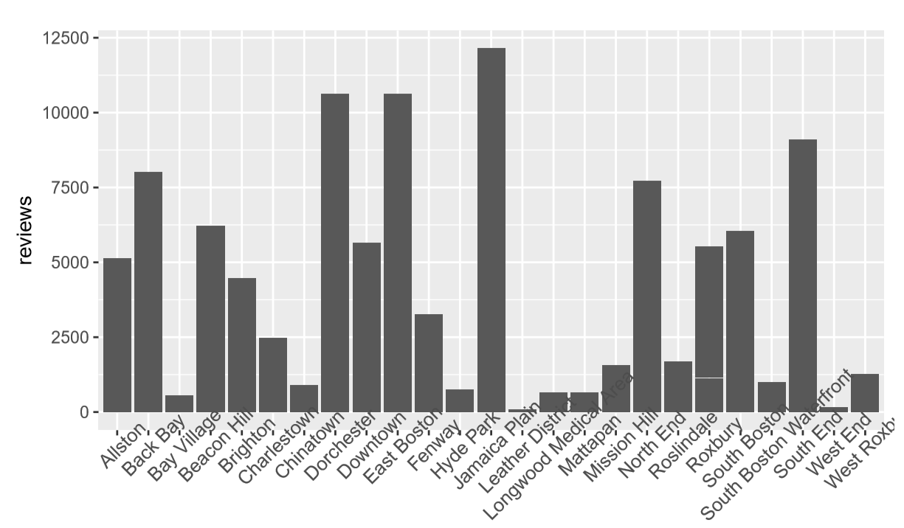
EDA example(details in report)
Total reviews from different neighborhood in chicago

Slide 5
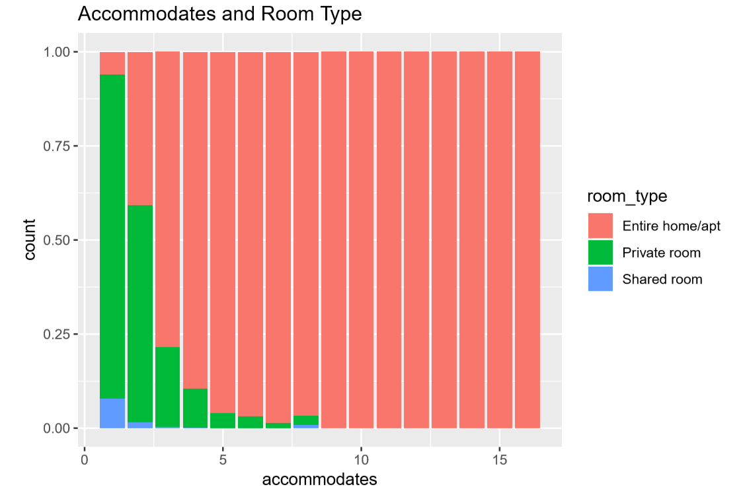
Continued(EDA)
Entire home tends to allow more accommodates

Slide 6
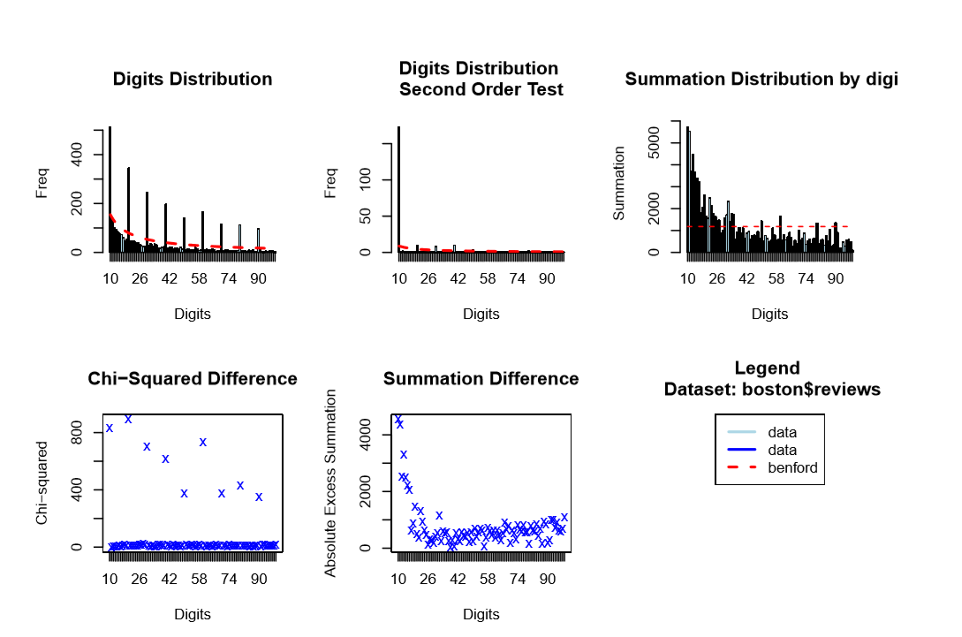
Benford Analysis example(more in report)
The original data is in blue and the expected frequency according to Benford's law is in red.
Digit Distribution Second Order Test calculates the digit frequencies of the diﬀerences between the ordered (ranked) values in a data set.

Slide 7
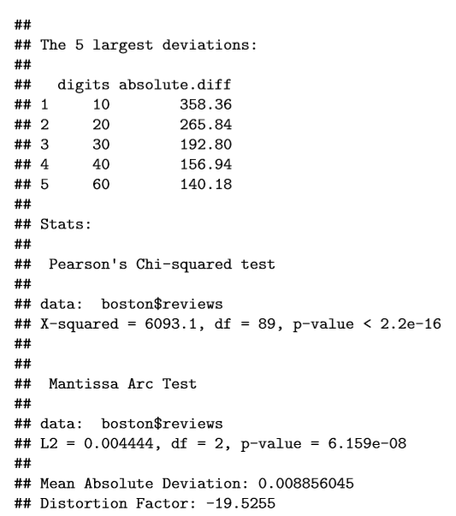
Continued(Benford analysis)
A part of summary of Benford analysis
Include the 5 largest deviations
Mantissa Arc Test
Pearson’s Chi-squared test

Slide 8
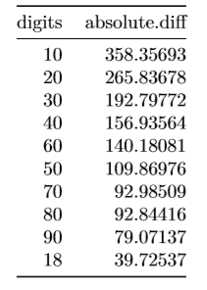
Continued(Benford analysis)
Table shows ten suspected two digits that contain most discrepancies from Benford’s law.

Slide 9
Conclusion
EDA part:
  Large amount of zeros on reviews suggesting that host needs to find a way to encourage their guests to give the feedback on the website.
  Rating and reviews are correlated in a positive way.
  Entire home/apt is a majority type of Airbnb house with more bedrooms and higher price.
  Reviews does not affect price very much.
Benford analysis part:
  The variable of review and graph are in a good shape. The largest deviation always start with the smallest number.
  The variable of price has some problem. The largest deviations always start with a much larger number suggesting that it does not follow the distribution very well.
  The results of the total data which combines three cities also support this conclusion. Thus, in this dataset, reviews are good to trust, but we need to think more while looking at the price.

